Slide 1
Speech Emotion Detector Design
Mitesh Puthran
Derek Hung

Slide 2
Introduction
Detects emotion through speech
Uses five emotions: fearful, anger, happy, sad, calm
Can be used in variety of functions
Marketing
Safety- cars

Slide 3
Dataset
We used two datasets:
The Ryerson Audio-Visual Database of Emotional Speech and Song
24 Actors(12 female and 12 males)
Surrey Audio-Visual Expressed Emotion (SAVEE)
4 Actors (4 males)
All the audio files are in wav format.
The audio files have unique identifiers which allow us to classify them into 5 different emotions .

Slide 4
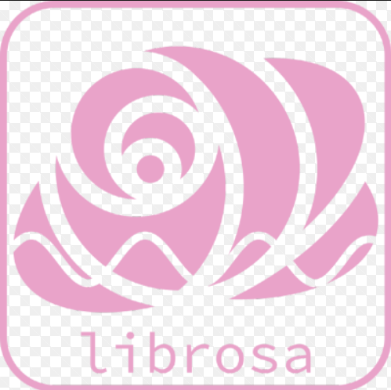
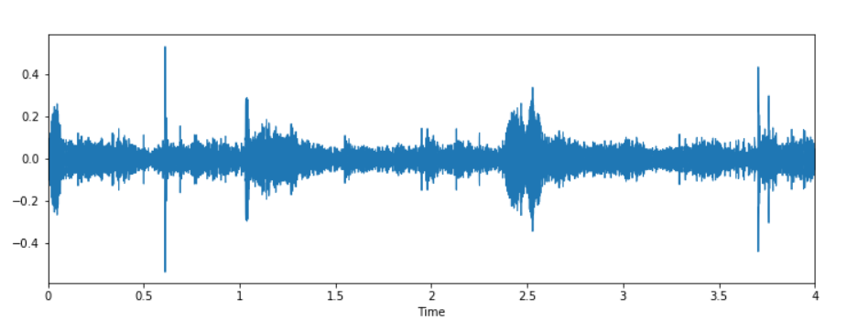
Processing data
Loading data to extract features
Librosa is the library for music and audio analysis.
Features are MFCC(Mel Frequency Cepstral Coefficient). (Array of values) which are extracted from the audio files
Separated out males and females voice.
Audio files were processed at 44Khz to extract more unique features from the audio files.

Slide 5
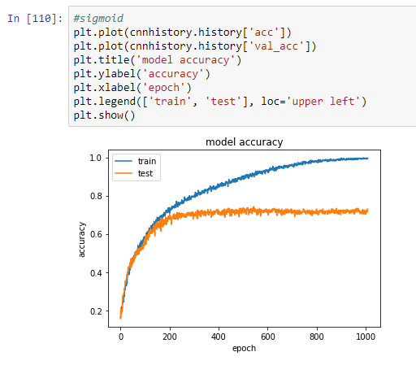
Model building
Started out with MLP, LSTM and CNN models
CNN gave better accuracy due to our project being a classification problem.
Tuned CNN further to get max accuracy.

Slide 6
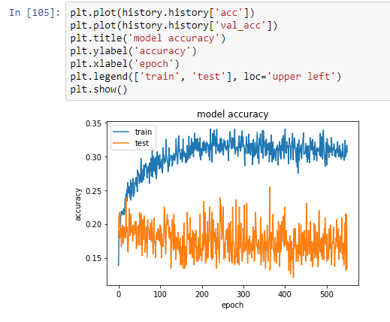
MLP
Built a 8 layer MLP model which gave an accuracy of around 25% which was very low with epoch size of 550 and batch size of 32.

Slide 7
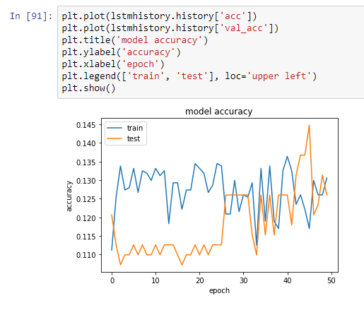
LSTM
LSTM model gave an max accuracy of 15 % on 50 epochs and batch size of 32.

Slide 8
CNN
CNN model was suited for our classification problem. So after tuning it we were able to get a maximum accuracy of around 70% for 1000 epoch and batch size of 32.

Slide 9
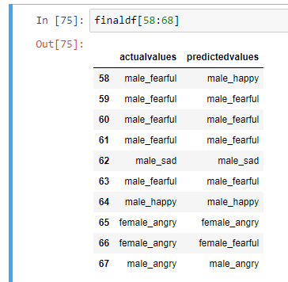
Prediction
After training the model, we tested it out on our test data to get the following results

Slide 10
Live demo

Slide 11
Conclusion
CNN worked best
Model accurately identified male and female voice everytime.
In the future we could use sequence to sequence model to generate different sounds based on emotions.

Slide 12
Thank you

